Slide 1

Your wellness guide

Slide 2
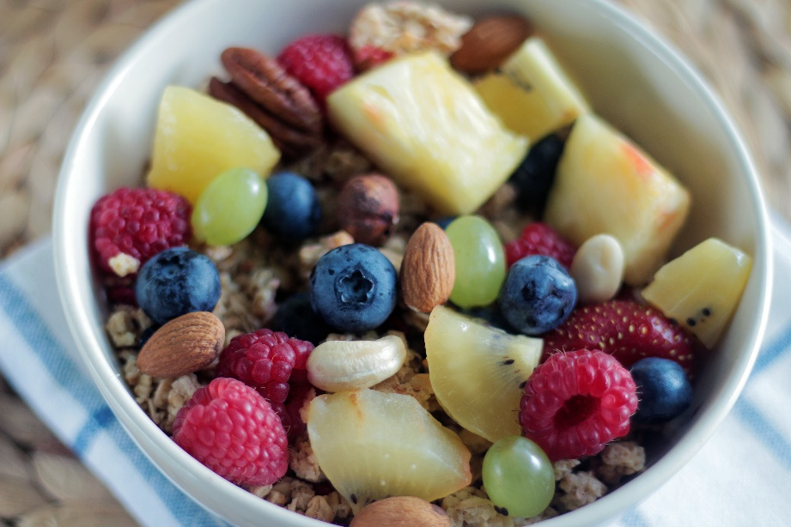
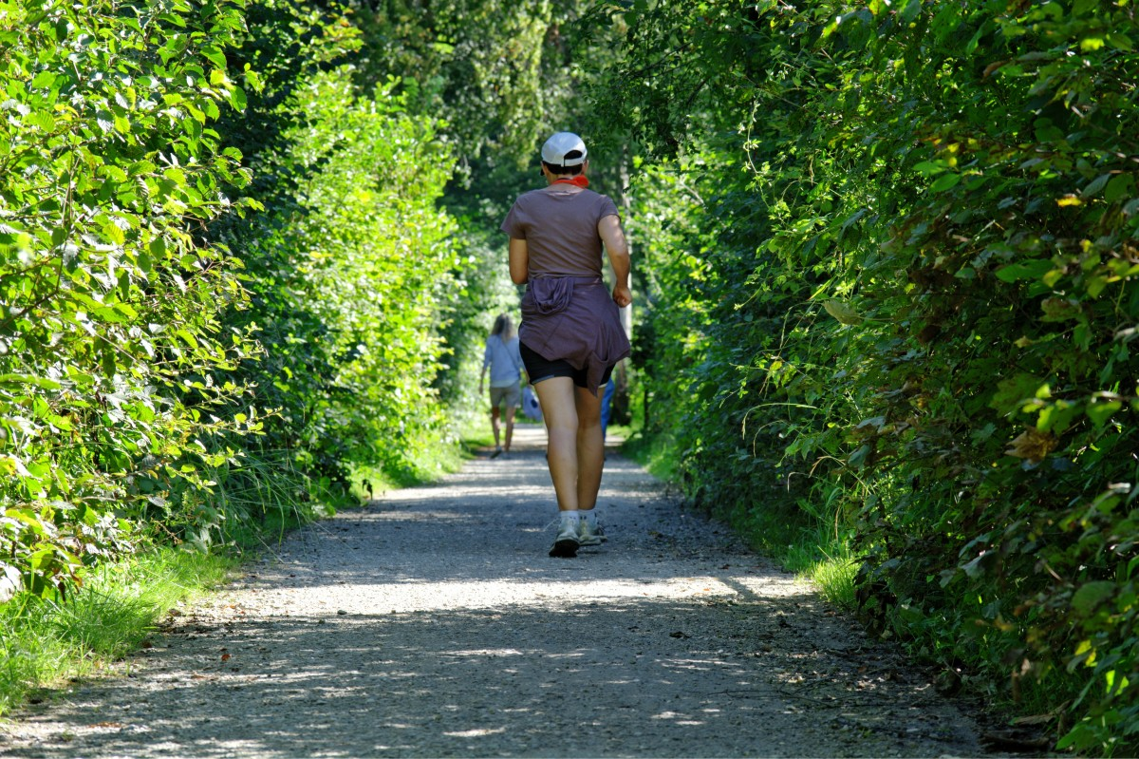
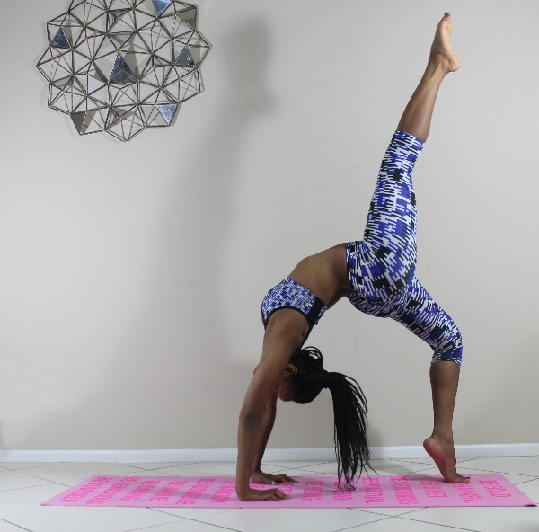
Health and nutrition
Buy and eat healthy, nutritious meals.
Eat 5 portions of fruit and vegetables a day.
Drink plenty of water to keep hydrated.
Boredom and stress eating are a common reaction: plan your meals and snacks ahead.
Exercise regularly, this can be as a simple as a walk with a dog.
Be active- participate in a sport you enjoy.
Try something new, lots of exercise can be completed in the comfort of your own home. Free exercises are available online.
Yoga can be a great form of exercise and also helps calm the mind and body which reduces stress.

Slide 3


Sleep hygiene
From the age of 12 you need 8-9 hours sleep minimum every night.
Not having enough sleep will impact your mental and physical well-being.
Set a good routine before bedtime.
Turn of electronics and do a calming activity; reading, journaling or drawing to relax your mind and body before sleep.
Journaling can also give the opportunity to appreciate the positives that have happened during your day.
Set an alarm for the following morning.
This Photo by Unknown Author is licensed under CC BY-SA-NC

Slide 4

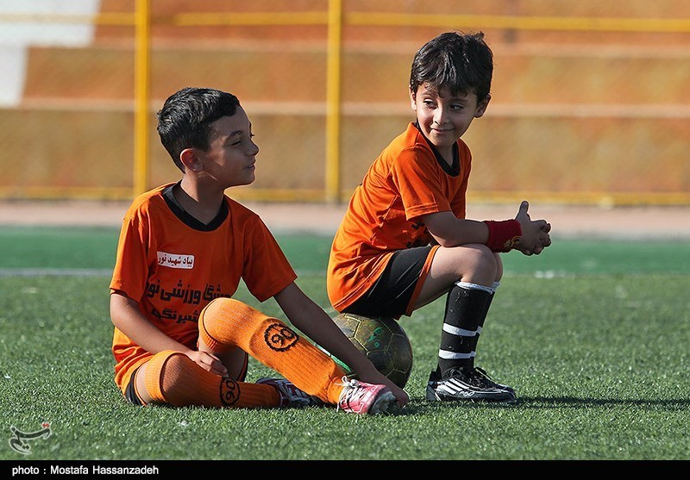
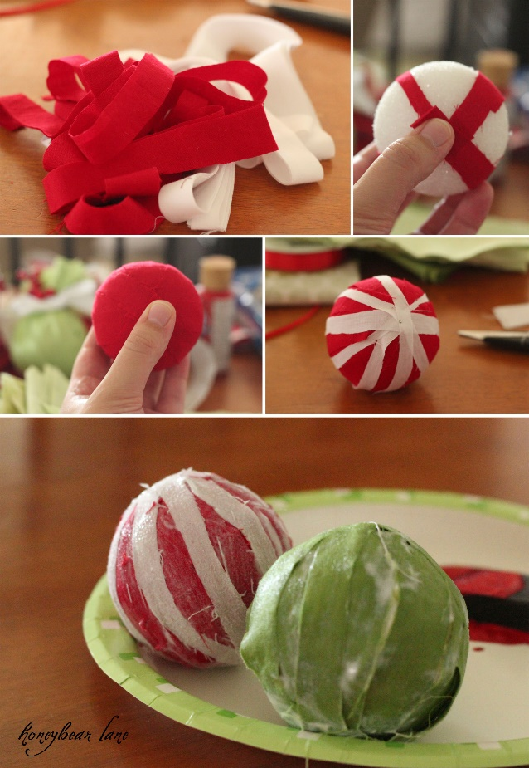




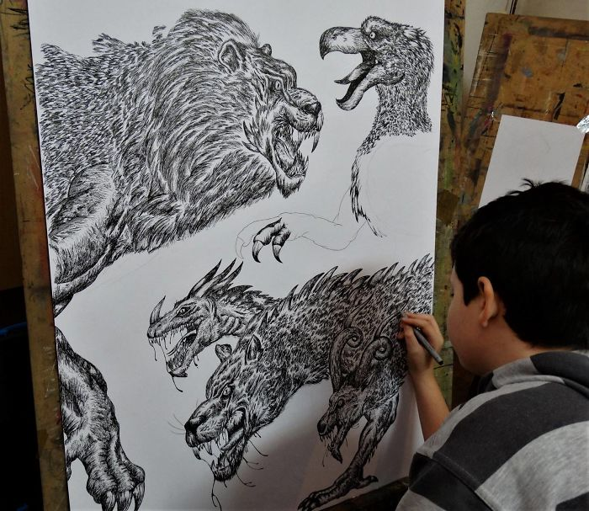
Enjoyment
Make sure you spend time doing things you enjoy.

Slide 5
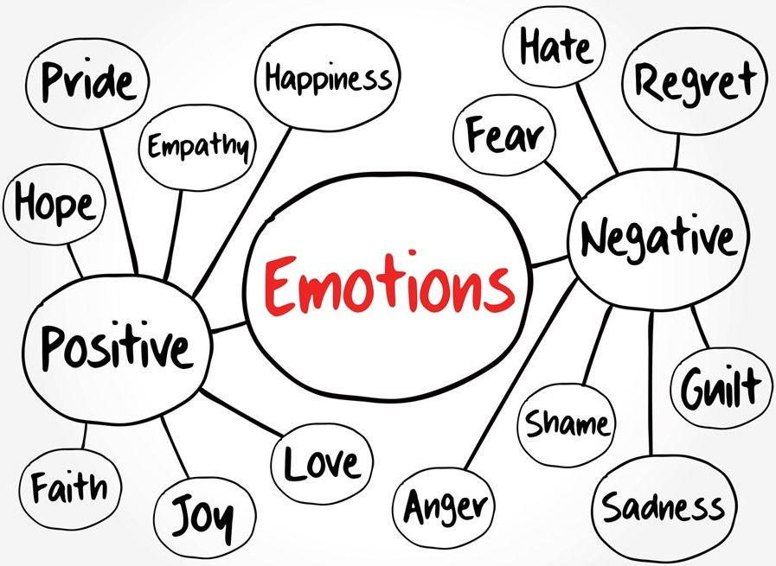
It’s Okay to not feel Okay
Talk to someone you trust.
Don’t keep it any worries to yourself.
Reach out for support using approved sites for well-being.
Complete activities you enjoy.
Spend time with friends.
Above all remember that it is Okay to feel sad, angry, frustrated, worried- these are normal emotions just the same as happiness and excitement.

Slide 6







Useful websites to support well-being

